Slide 1

Welcome to my home town of hainan

Slide 2
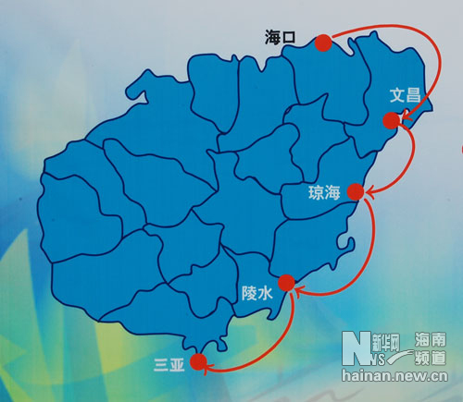
Hainan province is located in the southern China, including hainan island of hainan province and the xisha islands, the zhongsha islands and the nansha islands of the reef and its waters.
海南省位于中国最南端，海南省包括海南岛和西沙群岛、中沙群岛、南沙群岛的岛礁及其海域。

Slide 3
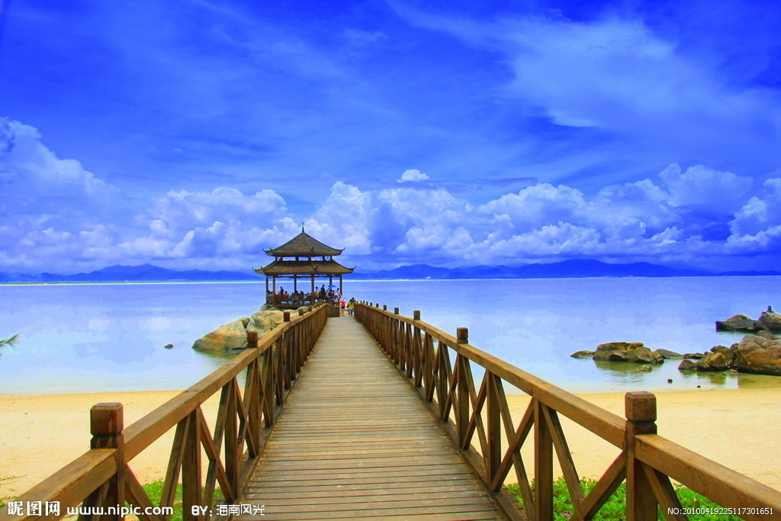
Hainan is the area of China's land is minimum, area's biggest provinces.
海南省是中国陆地面积最小，海洋面积最大的省。

Slide 4
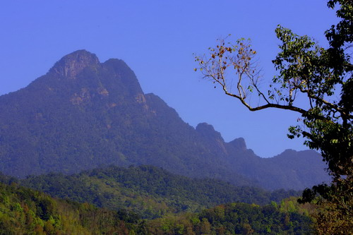
Hainan is wuzhishan first mountain, is the symbol of hainan island, China is one of the famous mountains,
五指山是海南第一高山，是海南岛的象征，

Slide 5
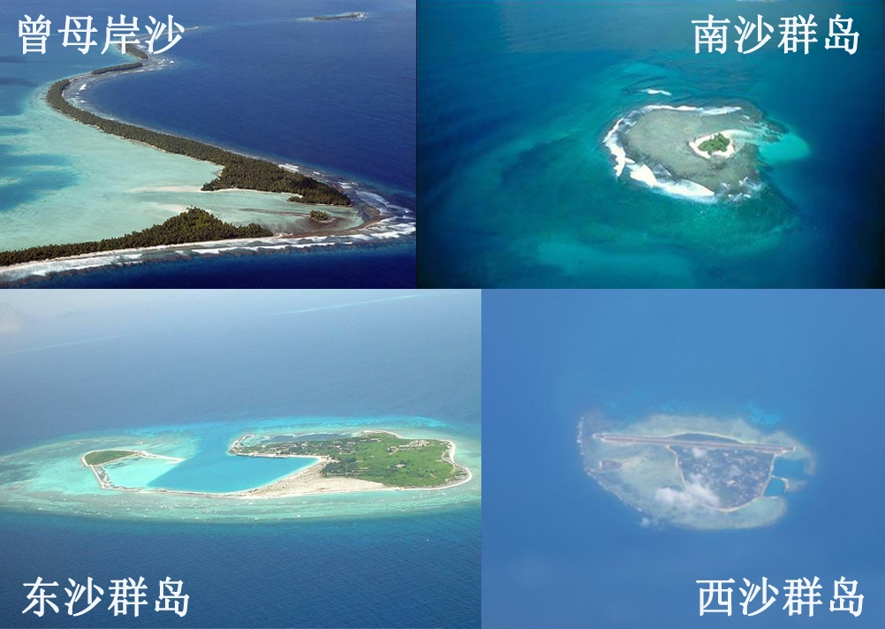

Slide 6
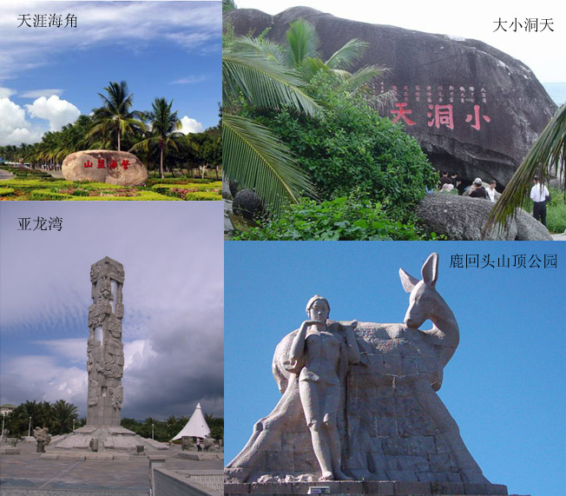

Slide 7
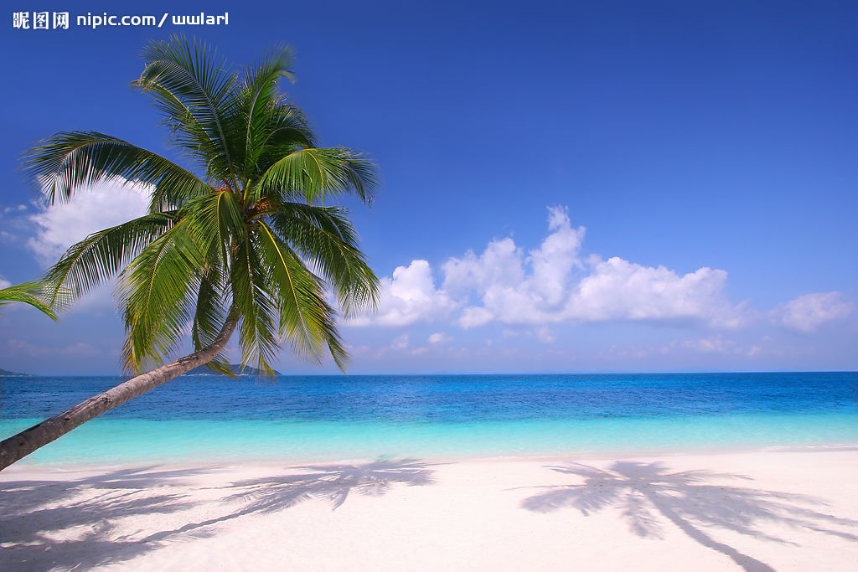
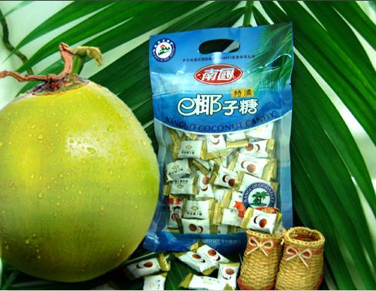
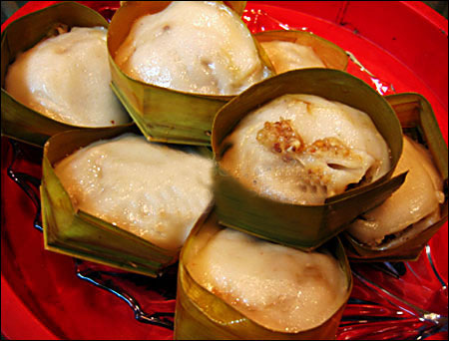
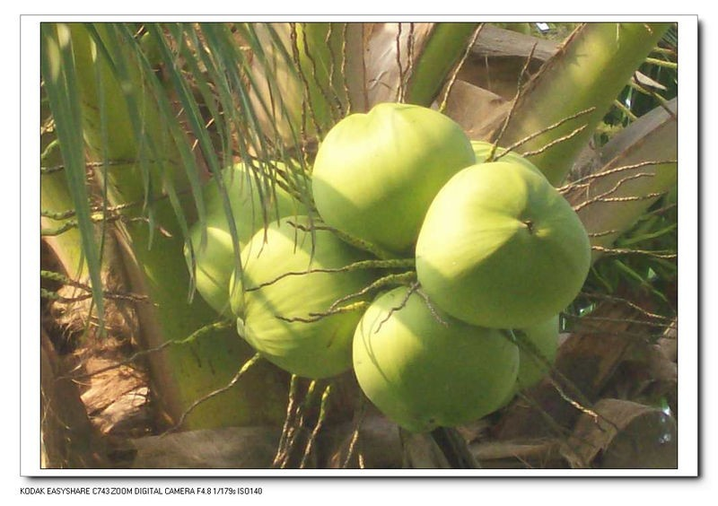
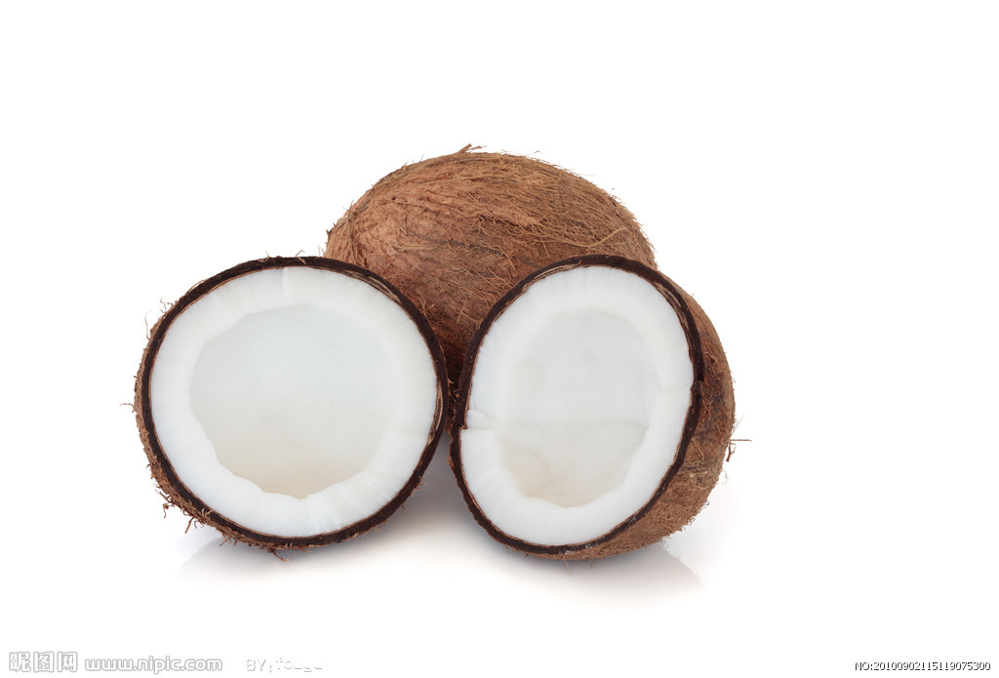
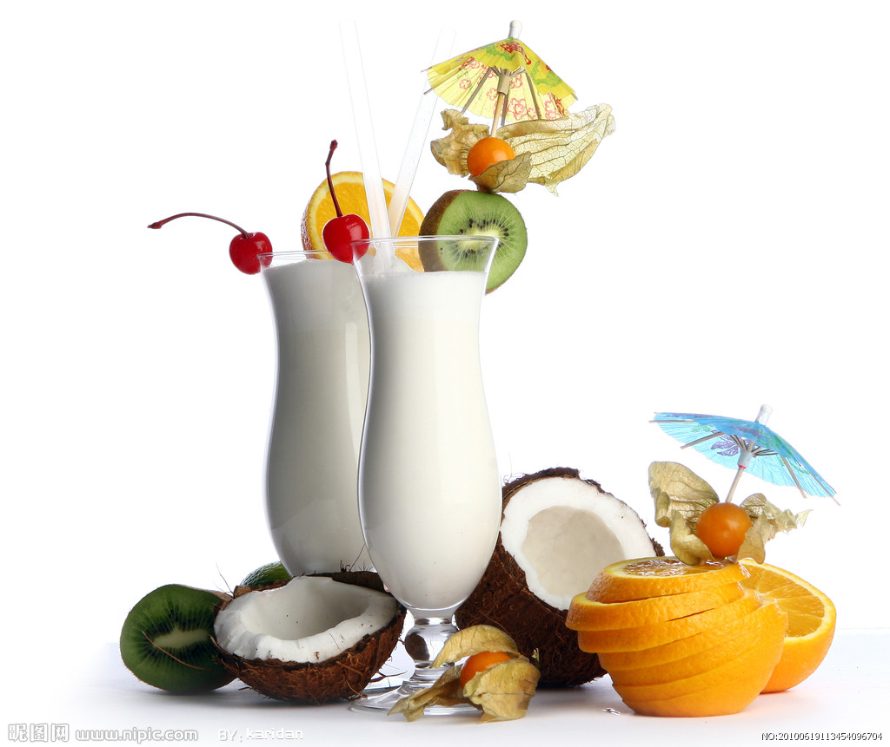
Appreciate so much beauty, everyone should also tired hungry. To introduce below the hainan food. First of all, of course, is a tropical fruit.
欣赏了这么多美景，大家应该也累了饿了。下面给大家介绍海南的美食。首先当然是热带水果。
coconut
椰子

Slide 8

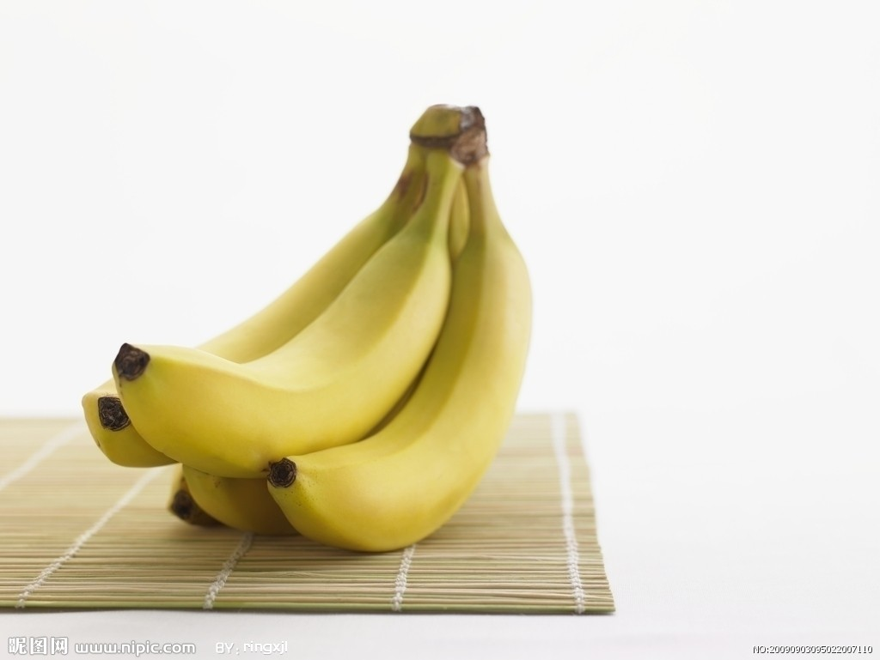
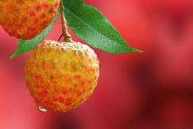
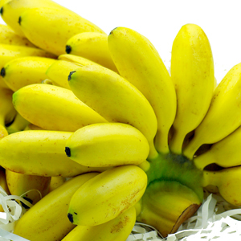
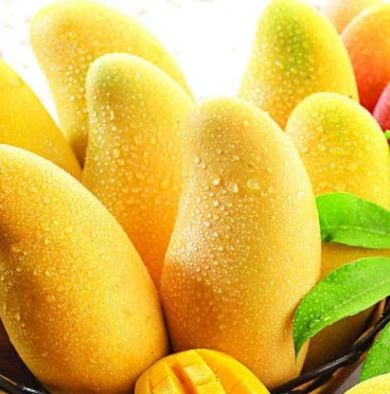
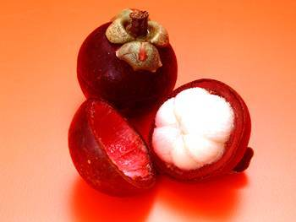

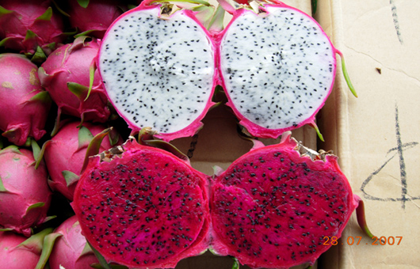
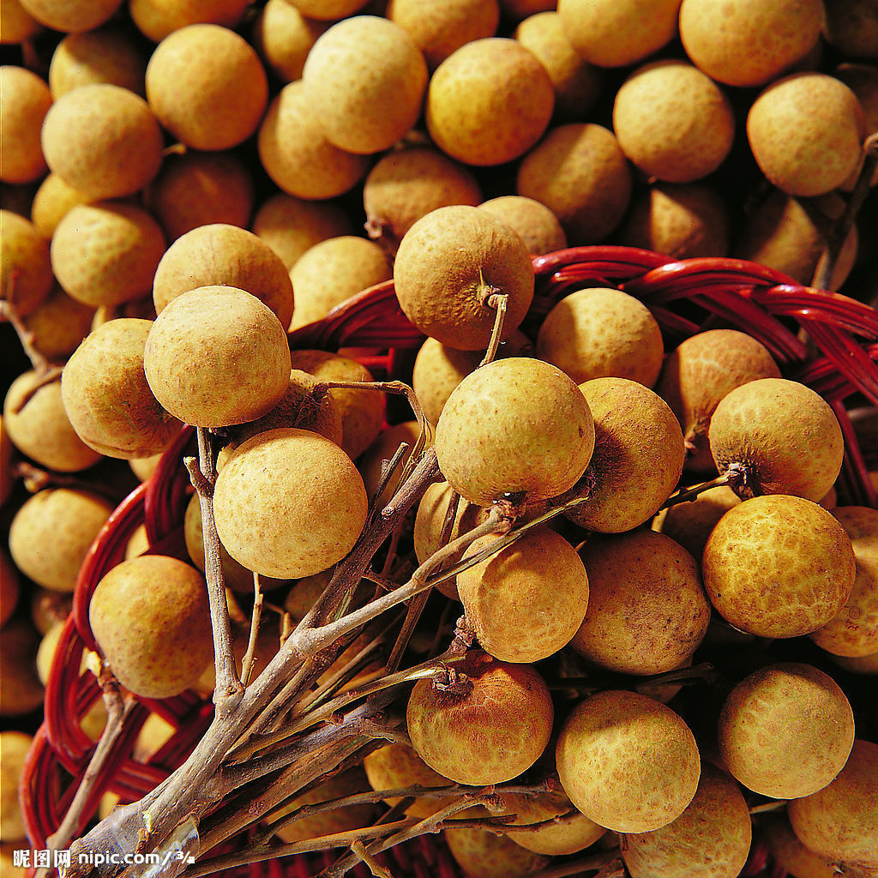
皇帝蕉 Musa AA
banana
Litchi Chinensis Soon荔枝
mango芒果
pitaya火龙果
orange
mangosteen
山竹果
桂圆 longan

Slide 9
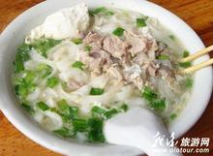
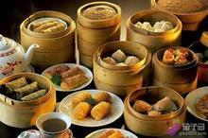
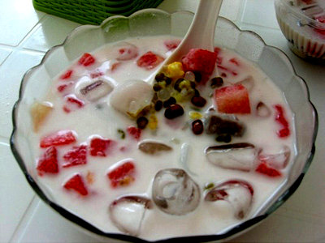
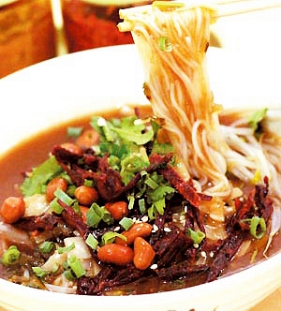
The next street is all kinds of food，
The ChiHuo see come over。
接下来是各种街头美食，吃货们看过来。
后安粉
Ann powder after
Dad tea
老爸茶
Coconut milk qing fill cool
椰奶清补凉
抱罗粉
Embrace ROM powder

Slide 10
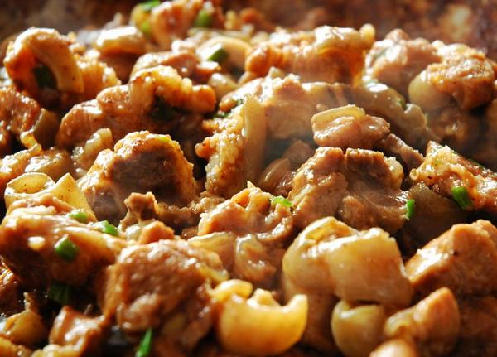
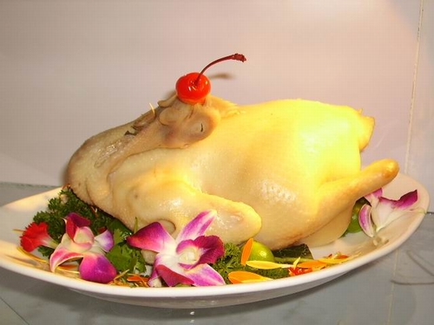
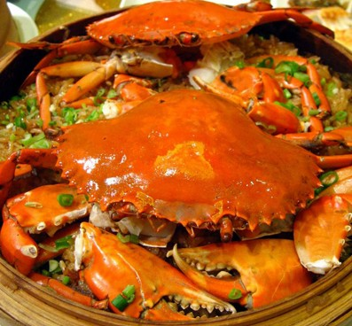
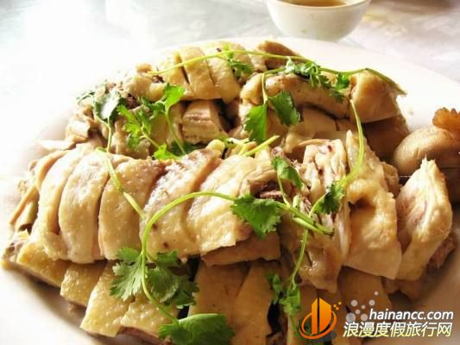
白切东山羊boiled sliced Dongshan mutton
WenchangChicken
文昌鸡
Hainan "four famous"
海南“四大名菜”
白切加积鸭boiled sliced Jiaji duck
And crab
和乐蟹

Slide 11
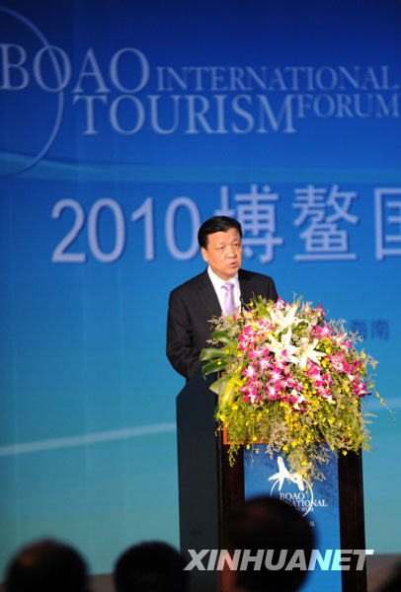
To introduce the culture and other next hainan。
再为大家介绍下海南的文化以及其他。
Boao Asia forum.
博鳌亚洲论坛会。

Slide 12
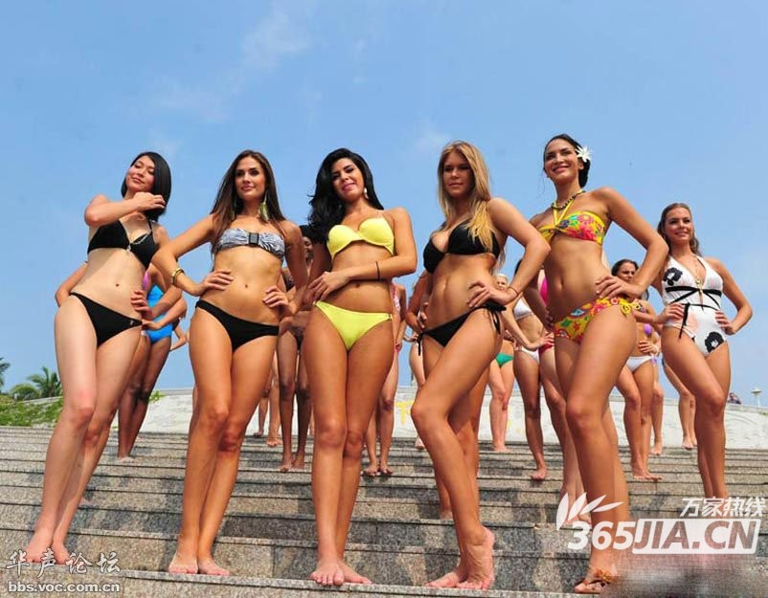
57 th miss world held in sanya, sanya added for a beautiful scenery.
第五十七届世界小姐在三亚举行，为三亚增添了一道亮丽的风景。

Slide 13
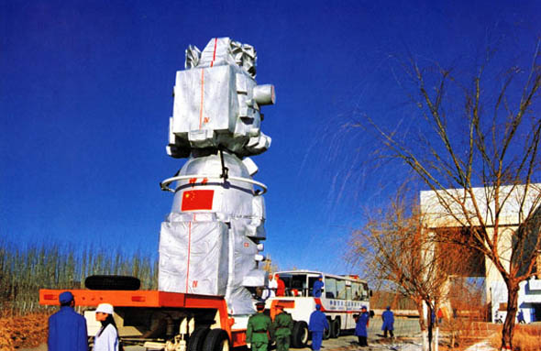
China's new hainan satellite launch base中国新建海南卫星发射基地

Slide 14
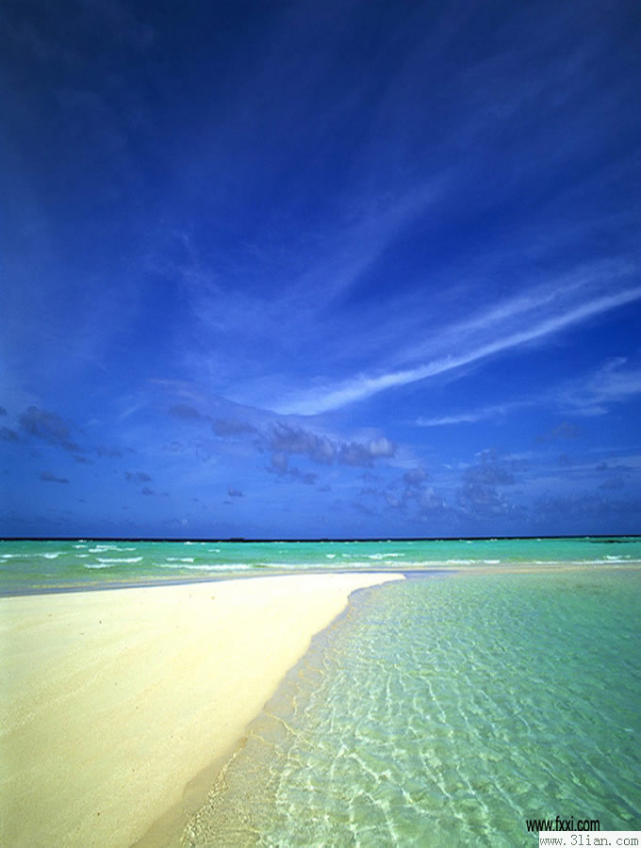
And, this is my hometown of true love, hope you can like this beautiful place.
这，就是我挚爱的家乡，希望大家也能喜欢这个美丽的地方。
hainan welcome you."
海南欢迎您。”

Slide 15

国贸11-1
赵娴

